Slide 1

Image Labels Generator Using AWS Rekognition
PRESENTED BY: GOURI DUMALE (G49564205)

Slide 2
PROJECT DEFINITION AND SCOPE
The Image Labels Generator is an AWS-powered tool that automatically identifies and labels objects in images using Amazon Rekognition, an AI-based image analysis service.
It simplifies image categorization by automating tasks that would typically require manual effort, making it ideal for applications like digital asset management, automated tagging, and content moderation.
This utilises serverless AWS services such as S3, Lambda, Rekognition, and Cognito, which helps in overall project being scalable and cost-efficient.
Secure access to AWS services using Amazon Cognito for authentication and authorization.

Slide 3
KEY FEATURES
Support for JPEG, JPG, and PNG file uploads.
Integration of AWS SDK in the front-end to upload and fetch results from S3.
Real-time rendering of bounding boxes on the user interface.
Fully automated backend workflow using S3, Lambda, and Rekognition.

Slide 4
AWS SERVICES USED
AWS Amplify: To host the front-end application (in collaboration with github)
Amazon S3: For image storage and saving results
AWS Lambda: To process images and invoke Rekognition
AWS Rekognition: For object detection and bounding box generation
IAM Roles and Policies: For secure access between AWS services
Amazon Cognito: To manage authentication for image uploads

Slide 5
IAM ROLES
Role 1: Permissions for AWS SDK to interact with S3.
Role 2: Amplify access for hosting and Cognito integration.
Role 3: Lambda execution role for Rekognition API access and S3 write permissions.

Slide 6
DATA SOURCES
Link:
https://github.com/AishwaryaMaddula/ImageDetection/tree/main/dataset
https://www.kaggle.com/datasets/antoreepjana/animals-detection-images-dataset/data

Slide 7
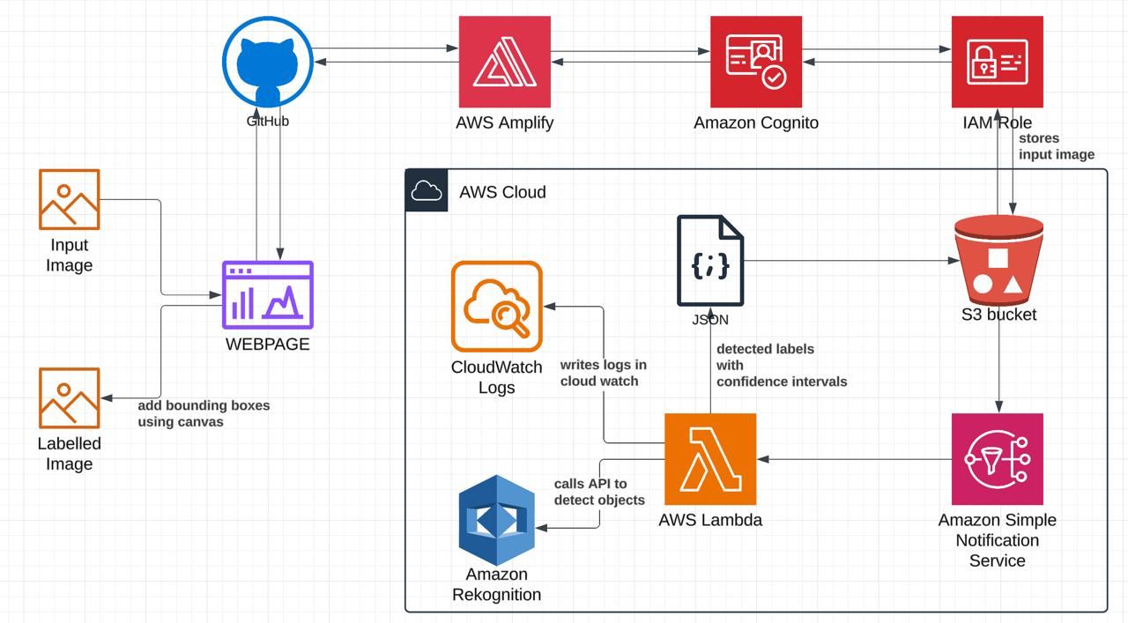
PROJECT ARCHITECTURE

Slide 8
PROJECT IMPLEMENTATION
Created IAM Roles for Cognito, S3 and Amplify
Created Identity pool in Cognito
Created S3 bucket and gave permissions for GET, PUT and POST from the bucket using the IAM role and policy.
Created lambda function to take the image from s3 and trigger AWS rekognition. The response of identified objects with confidence intervals and coordinates for bounding boxes for the objects are saved as json in the same s3 bucket in results folder.
Enabled cloudwatch for the lambda function.
Configured S3 notification to trigger lambda function when the input image is stored in s3 bucket
The frontend website(index.html) is coded using html, css and javascript for invoking image upload to s3, fetching json content and adding bounding boxes based on coordinates using canvas and display it.
Saved the index.html file in github and deployed the application from Github in Amplify. Assigned Role created for Amplify.
Enabled CORS for the s3 bucket inorder to allow amplify to access the json file from bucket.

Slide 9
DATA FLOW
Access website and upload input image
Input image is uploaded to S3 bucket with the help of cognito created and waits for json content in /results folder(polling is done)
S3 notification is triggered immediately once there is an image upload and lambda function is invoked
lambda takes the input image, calls aws rekognition and gives response of detected objects, confidence intervals and coordinates for bounding boxes of objects identified. The result is saved in /results folder in json format
AWS Cloudwatch monitors and writes logs everytime image is uploaded in website and lambda is invoked.
Once the json file is available, javascript reads it and add bounding boxes based on coordinates using canvas and displays it as output.

Slide 10

DEMO

Slide 11


SAMPLE RESULTS SCREENSHOTS
Input Image
Output Image

Slide 12
REFERENCES
Architecture Design: https://www.youtube.com/watch?v=5oonyR-CyME
Lambda for Image Detection: https://docs.aws.amazon.com/rekognition/latest/dg/labels.html
Amplify Hosting: https://docs.aws.amazon.com/amplify/latest/userguide/welcome.html
Roles: https://docs.aws.amazon.com/IAM/latest/UserGuide/id_roles.html
Cognito: https://docs.aws.amazon.com/cognito/latest/developerguide/cognito-identity.html
S3 bucket: https://docs.aws.amazon.com/AmazonS3/latest/userguide/UsingBucket.html
Html, Javascript, CSS: https://www.w3schools.com

Slide 13

QUESTIONS?

Slide 14

THANK YOU

